Slide 1
PROJECT PROPOSAL
Fire&AIce

Slide 2
WHAT?
We plan to host the European championship for Portuguese horses, which will involve organizing various horse-related events, competitions, and ceremonies over a specified period.

Slide 3
WHO?
The executive board will oversee the entire event. Specific committees will be formed for logistics, event management, marketing, and finance. Volunteers from the association will also be involved in various capacities.

Slide 4
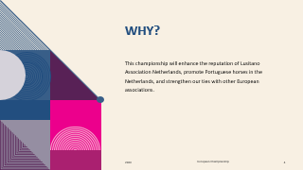
Why?
This championship will enhance the reputation of Lusitano Association Netherlands, promote Portuguese horses in the Netherlands, and strengthen our ties with other European associations.

Slide 5
HOW?
Means
Estimated budget
We will collaborate with local event organizers, horse trainers, and other stakeholders.
Between €50k to €100k, based on previous championships.
resources
Source of income
Necessary resources include venues, horse facilities, equipment, and manpower.
Sponsorships, ticket sales, and a portion of LVN's funds.
FINANCIALS
Available Funds: €18,653 (Equity)

Slide 6
When?
Start
end
Immediately upon approval.
Championship's conclusion,
two years from now.

Slide 7
FINANCIALS
BALANCE | ASSETS | LIABILITIES
Bank account | 489
Savings account | 17705
Debtors | 2156
Creditors |  | 1697
Equity |  | 18653
 | 20350 | 20350
EXPENSES | IN | OUT
Annual horse breeding show | 3336 | 6748
Other horse events | 933 | 4383
Member's magazine | 1404 | 5386
Studbook administration | 2738 | 1049
Association board costs and organization |  | 2573
Membership fees | 11470
Other | 223 | 524
 | 20104 | 20663
Loss | 559
 | 20663 | 20663

Slide 8
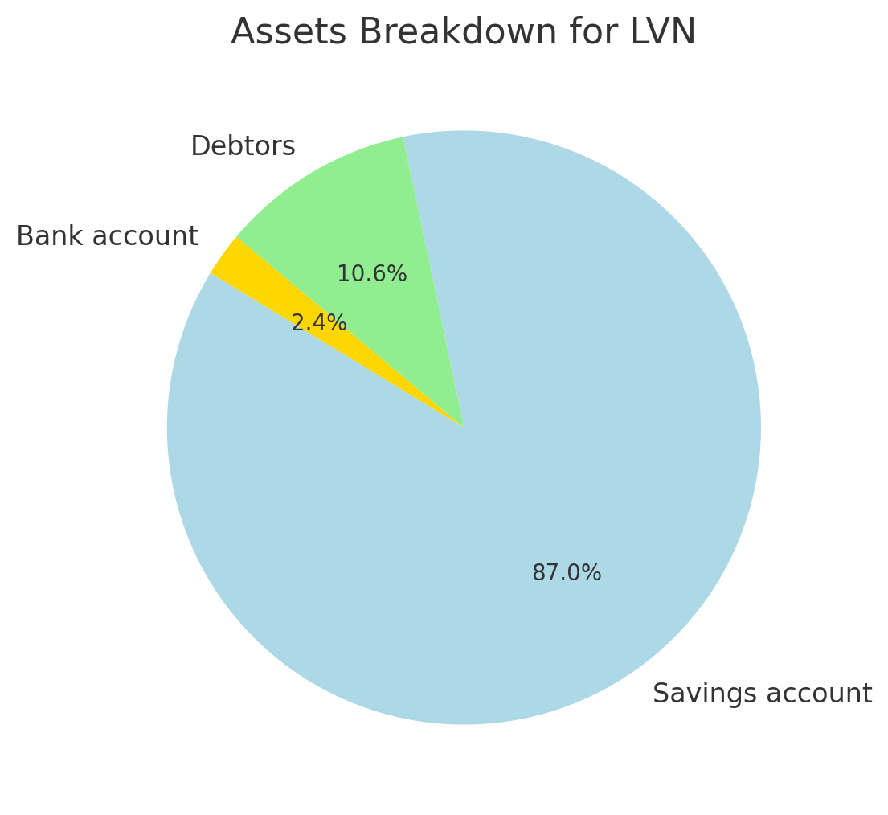
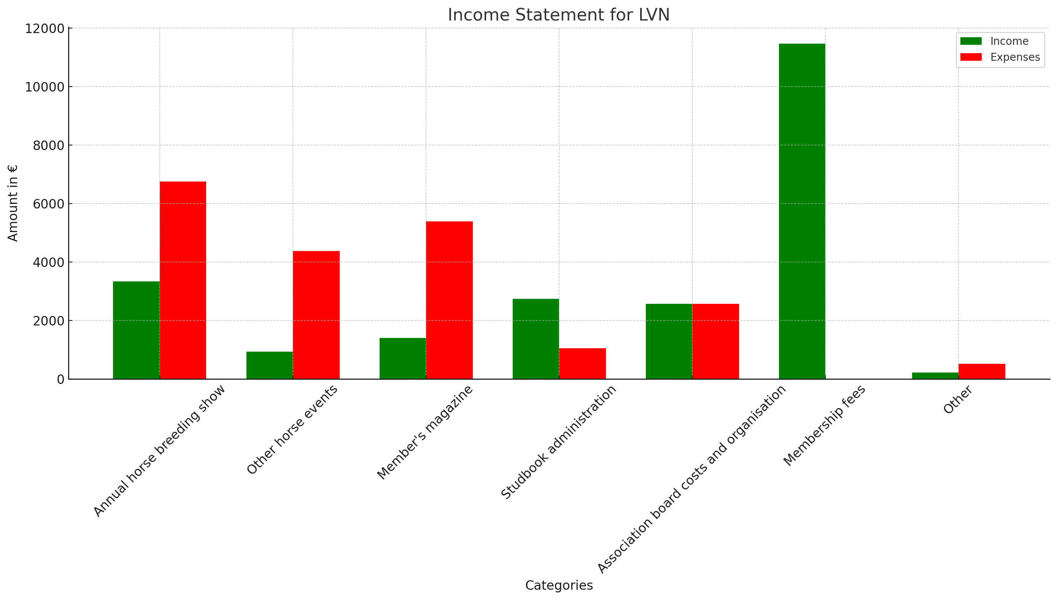
FINANCIALS

Slide 9
Event Financing
Estimated required budget: €50.000 - €100.000
Saving account: €18.000
Predicted loan: ~€50.000
Predicted budget: ~€68.000
Predicted loan payback time: ~10-12 years
Predicted loan payback amount: ~€5.500 / year
Member's magazines yearly cost: €5386
Possible way to finance the loan would be to digitalise the member's magazines.

Slide 10
STAKEHOLDER ANALYSIS
Bank
Local government
LVN Members
KEEP SATISFIED
MANAGE CLOSELY
Sponsors
POWER
MONITOR
Participants and competitors
KEEP INFORMED
Volunteers and staff
Portuguese Horse Breeders and Enthusiasts
INTEREST

Slide 11
Swot Analyse
Strengths:
Expertise: LVN is good at managing horse events.
Community: Strong member base for volunteer help.
Weaknesses:
Budget: Estimated costs are higher than available funds.
Staff: Not enough full-time people for the work needed.
Opportunities:
Visibility: Big chance to get LVN noticed more.
New Members: Could attract more people to join LVN.
Threats:
Financial Risk: If ticket sales and sponsorships don't meet expectations, LVN could face a financial loss that depletes its reserves.
External Factors: Bad weather or economy could hurt the event.

Slide 12
SUMMARY
Given our limited available funds of €18,653 and an estimated budget of €50k to €100k, we recommend against organizing the European championship for Portuguese horses at this time. The financial risks could threaten LVN's stability. We should focus on securing more funds before revisiting this opportunity.

Slide 13
THANK YOU

